Slide 1
How to Choose a Deep Network, and What Do Deep Networks Learn?
Deep Learning in Practice Seminar
Scott Wisdom
June 22, 2017

Slide 2
Outline
How to choose a deep network for my data?
  Example: ReLU activations correspond to iterative optimization of LASSO
  Application: interpretable model-based ReLU recurrent networks for audio source separation

Slide 3
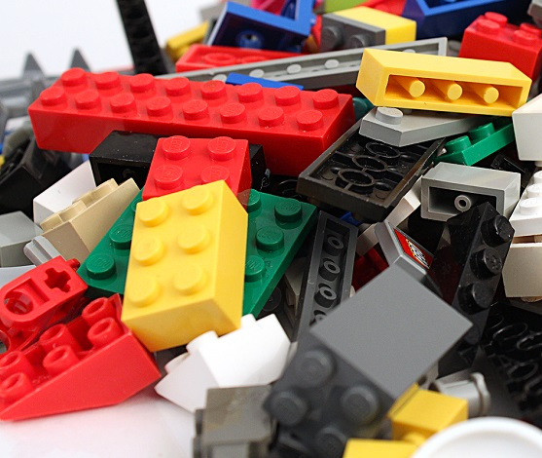
How to choose a deep network for my data?
DNNs consist of layers that we stack together and train with backpropagation…
but how do we pick the right combination of layers?
Batch
normalization
tanh
ReLU
Dropout
LSTM

Slide 4
How to choose a deep network for my data?
Some architectural choices are obvious:
  Sequential data: use recurrent neural networks
  Image data: use convolutional neural networks
Other choices are not so obvious:
  Activation function: ReLU, PReLU, tanh, ???
  Initialization of weights?
  Regularization of weights?
  How many layers? How many hidden units?
Not-so-obvious choices determined in two ways:
  Empirically explore the space of choices, guided by intuition, luck, and ???
  Unfold existing algorithms, e.g. inference algorithms for statistical models

Slide 5
Outline
How to choose a deep network for my data?
  Example: ReLU activations correspond to iterative optimization of LASSO
  Application: interpretable model-based ReLU recurrent networks for audio source separation
What do deep networks learn?
  Deep dream for convolutional neural networks

Slide 6

Statistical model-based explanation of ReLU
x
D
h
v
=
+
(Fx1)
Observed
data
(FxN)
Sparsifying
dictionary
(Fx1)
Additive
Gaussian
noise
(Nx1)
Sparse
hidden
state
LASSO
[Tibshirani 1996]
Given x and D, infer h by minimizing the negative log-likelihood:
Squared error between observations and model
Promote
sparsity

Slide 7

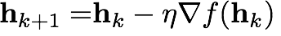
Statistical model-based explanation of ReLU
Given x and D, infer h by minimizing the negative log-likelihood:
The cost function is a sum of a smooth term and a non-smooth term
Because of the non-smooth term, conventional gradient descent is slow (convergence error rate of )

Slide 8
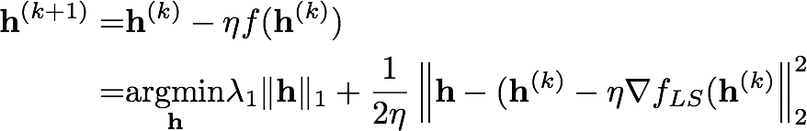
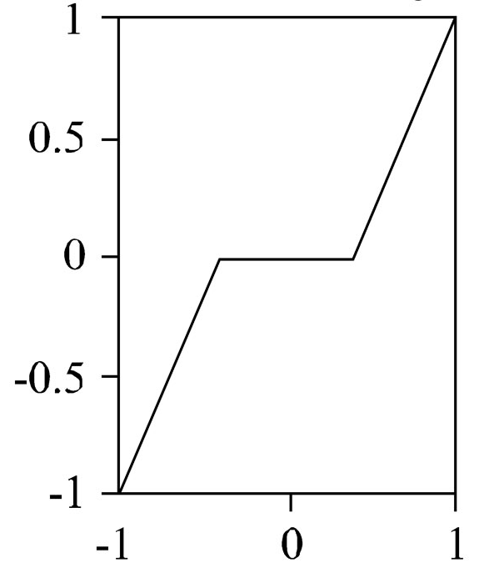
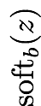
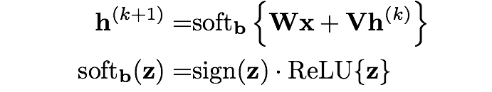
Statistical model-based explanation of ReLU
How can we speed up optimization? Reformulate the gradient descent step into proximal form:
Non-smooth
part
L2 penalty: don’t move too far from smooth gradient descent step
Solve for h, we get the following iterative soft-thresholding update:
Better convergence error rate of
A two-sided ReLU!
[https://blogs.princeton.edu/imabandit/2013/04/11/orf523-ista-and-fista/]

Slide 9


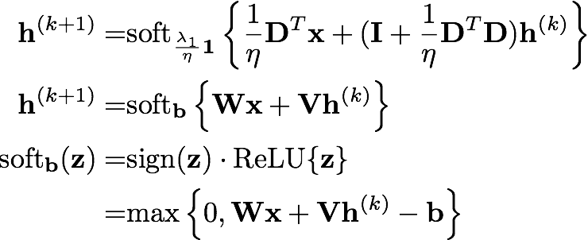

Statistical model-based explanation of ReLU
What does the iterative soft-thresholding algorithm (ISTA) look like as a computational graph?
A deep feedforward ReLU network!
(with inputs connected to each layer)
soft_{b}(.)
…
The “learned ISTA (LISTA)” network.
[Gregor and Lecun, "Learning fast approximations of sparse coding," (ICML-10)]
soft_{b}(.)
x
Notes:
\begin{aligned}
{\bf h}^{(k+1)}=&\mathrm{soft}_{\frac{\lambda_1}{\eta}{\bf 1}}
\left\{
\frac{1}{\eta}{\bf D}^T{\bf x} + ({\bf I}+\frac{1}{\eta}{\bf D}^T{\bf D}){\bf h}^{(k)}
\right\}
\\
{\bf h}^{(k+1)}=&\mathrm{soft}_{\bf b}
\left\{
{\bf W}{\bf x} + {\bf V}{\bf h}^{(k)}
\right\}
\\
\mathrm{soft}_{\bf b}({\bf z})
=&
\mathrm{sign}({\bf z})\cdot\mathrm{ReLU}\{{\bf z}\}
\\
=&\mathrm{max}
\left\{
0, {\bf W}{\bf x}+{\bf V}{\bf h}^{(k)}-{\bf b}
\right\}
\end{aligned}
\begin{aligned}
{\bf h}^{(k+1)}
=&
{\bf h}^{(k)}
-\eta
f({\bf h}^{(k)})
\\
=&
\underset{{\bf h}}{\mathrm{argmin}}
\lambda_1\|{\bf h}\|_1
+
\frac{1}{2\eta}
\left\|
{\bf h}-({\bf h}^{(k)}-\eta\nabla f_{LS}({\bf h}^{(k)}
\right\|_2^2
\end{aligned}

Slide 10
Statistical model-based explanation of ReLU
For statistical model inference, weights are tied.
But, when we’ve unfolded, no reason to tie weights anymore!
D^{(K)}
soft_{b}(.)
soft_{b}(.)
…
…
D
…
…
D⁽¹⁾
soft_{b}(.)
soft_{b}(.)
x
x
Notes:
\begin{aligned}
{\bf h}^{(k+1)}=&\mathrm{soft}_{\frac{\lambda_1}{\eta}{\bf 1}}
\left\{
\frac{1}{\eta}{\bf D}^T{\bf x} + ({\bf I}+\frac{1}{\eta}{\bf D}^T{\bf D}){\bf h}^{(k)}
\right\}
\\
{\bf h}^{(k+1)}=&\mathrm{soft}_{\bf b}
\left\{
{\bf W}{\bf x} + {\bf V}{\bf h}^{(k)}
\right\}
\\
\mathrm{soft}_{\bf b}({\bf z})
=&
\mathrm{sign}({\bf z})\cdot\mathrm{ReLU}\{{\bf z}\}
\\
=&\mathrm{max}
\left\{
0, {\bf W}{\bf x}+{\bf V}{\bf h}^{(k)}-{\bf b}
\right\}
\end{aligned}
\begin{aligned}
{\bf h}^{(k+1)}
=&
{\bf h}^{(k)}
-\eta
f({\bf h}^{(k)})
\\
=&
\underset{{\bf h}}{\mathrm{argmin}}
\lambda_1\|{\bf h}\|_1
+
\frac{1}{2\eta}
\left\|
{\bf h}-({\bf h}^{(k)}-\eta\nabla f_{LS}({\bf h}^{(k)}
\right\|_2^2
\end{aligned}

Slide 11
Outline
How to choose a deep network for my data?
  Example: ReLU activations correspond to iterative optimization of LASSO
  Application: interpretable model-based ReLU recurrent networks for audio source separation
What do deep networks learn?
  Deep dream for convolutional neural networks

Slide 12
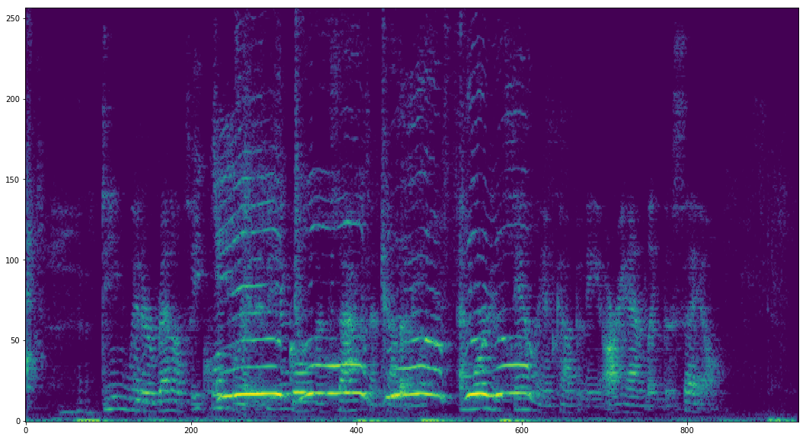
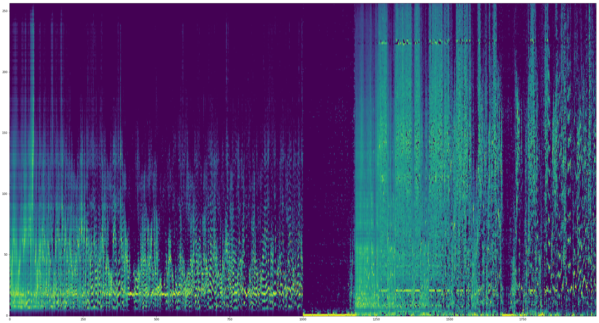
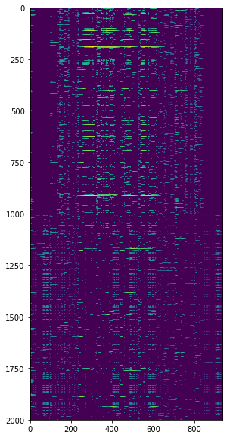
Interpretable ReLU RNN for audio source separation
A very successful model for audio source separation is
sparse nonnegative matrix factorization (SNMF),
e.g. [Hoyer 2002, Smaragdis 2004, Le Roux et al. 2015]
Factorizes the FxT spectrogram X into two nonnegative matrices:
  D, a FxN dictionary matrix (unit-norm columns)
  H, a NxT activation matrix (sparse)
=
X
D
H

Slide 13
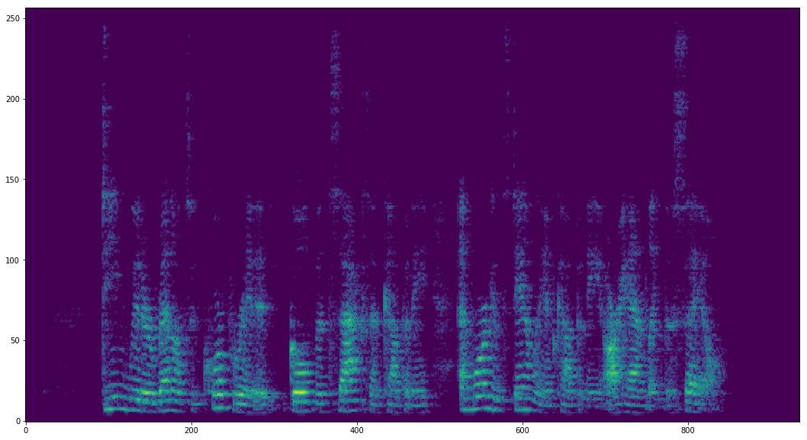
Interpretable ReLU RNN for audio source separation
We can enhance an audio source by building a mask from the partitions of the dictionary and activations:
D
H_{speech}
D_{speech}
D_{noise}
H
H_{noise}
D_{speech}H_{speech}
D_{speech}H_{speech}+D_{noise}H_{noise}
=
X
Mask
Enhanced X

Slide 14




Interpretable ReLU RNN for audio source separation
Unfolding ISTA for the sparse NMF model results in a RNN
Uses a deep feedfoward ReLU network at each time step
ReLU_{b}(.)
ReLU_{b}(.)
ReLU_{b}(.)
…
…
…
ReLU_{b}(.)
ReLU_{b}(.)
ReLU_{b}(.)
x_{t-1}
x_{t}
x_{t+1}
[Wisdom et al., NIPS 2016 workshop, ICASSP 2017]

Slide 15
Interpretable ReLU RNN for audio source separation
Results so far on CHiME2 dataset [Barker et al. 2013]
  7128 utterances with input signal-to-noise ratio (SNR) ranging from -6 dB to +9 dB
  Male or female speaker reading WSJ prompts
  Corrupted by real-world nonstationary noise recorded in a home environment
Model | Output SNR (measures separation quality, higher is better)
 | 100% of training | 10% of training
Sparse NMF | 7.71 dB | 7.43 dB
LSTM RNN | 12.35 dB | 10.59 dB
NMF ReLU RNN | 11.31 dB | 11.12 dB

Slide 16
Takeaway:
When deciding on a network architecture for your data, consider both
  Deep network components that have been shown to work well empirically
  Statistical models that have worked well for your data in the past
Inference in these statistical models can be turned into custom deep network components that are interpretable, exploit domain knowledge, and are tailored for your data
Combination of conventional and custom deep network components is very straightforward (often called “end-to-end learning” when all system components are differentiable and stacked together)

